Slide 1
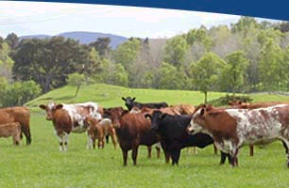
Introduction to
Animal Science

Slide 2
Competency 3.01
Recall Animal breed and sex terminology.

Slide 3
Animal Terminology
Species | Uncastrated Male | Immature Castrated Male | Immature Female | Mature Female | Newborn
Cattle | Bull | Steer | Heifer | Cow | Calf
Swine | Boar | Barrow | Gilt | Sow | Piglet
Poultry | Rooster | Capon | Pullet | Hen | Chick
Turkey | Tom |  | Pullet | Hen | Poult
Supplemental Animal Terminology
Sheep | Ram | Wether | Ewe Lamb | Ewe | Lamb
Goat | Buck | Wether | Doeling | Doe | Kid
Dog | Stud | Neutered | Bitch | Bitch | Puppy
Cat | Tomcat | Neutered | Molly | Queen | Kitten

Slide 4
Physical Characteristics
Intact Males –
  Generally more muscular overall
  Typically larger in stature and grow faster than females
  Often exhibit more muscle in the neck area

Slide 5
Physical Characteristics
Castrated Males
  Slower growing and have less muscle overall than the intact males
  Look for evidence of male genitalia such as a sheath to distinguish from females

Slide 6
Physical Characteristics
Mature Females
  Large body structure than immature females
  Mammary glands more evident when the animal is not lactating

Slide 7
Physical Characteristics
Immature Females
  Smaller stature than mature females
  Examine genitalia to distinguish from young male animals

Slide 8
Breeds of Livestock
Breeds are characterized by their phenotypic triats:
  Color and/or color pattern
  Frame and size
  Degree of muscling
  Environmental adaptions
    Extra skin to improve heat tolerance

Slide 9
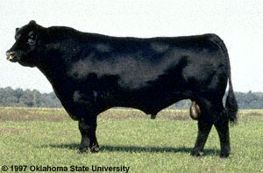
Angus

Slide 10
Beef Breeds
Angus
  Black
  Polled
  Originated in Scotland
  It is the most “registered” purebred
  High in carcass quality

Slide 11
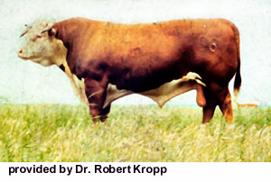
Hereford

Slide 12
Beef Breeds
Hereford
  Red and White face
  Horns
  Originated in England
  Docile
    Gentle temperament
  Good foragers
    Efficient converters of forage crops

Slide 13
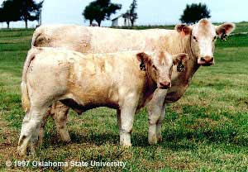
Charolais

Slide 14
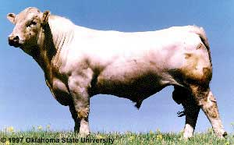
Charolais

Slide 15
Beef Breeds
Charolais
  White to light straw colored
  Naturally Horned
    Breeding-up has created polled animals
  Large framed
  Originated in France

Slide 16
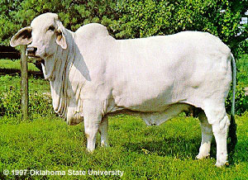
Brahman

Slide 17
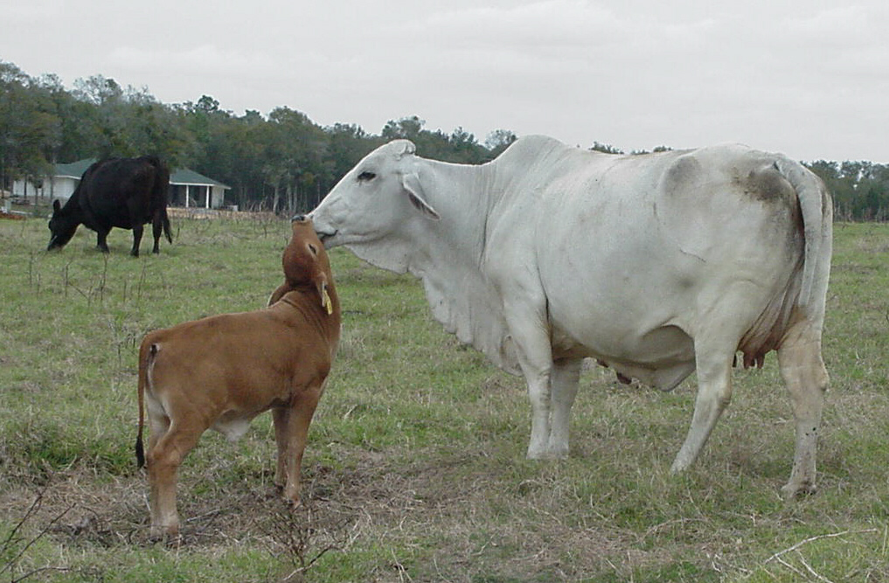
Brahman

Slide 18
Beef Breeds
Brahman
  Light Gray to Black or Red
  Originated in India
  Pronounced hump
  Loose Dewlap
  Insect tolerant
  Disease tolerant

Slide 19
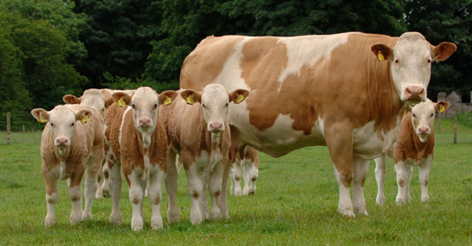
Simmental

Slide 20
Beef Breeds
Simmental
  Not set color pattern
  Large frame
  Rapid growing animal

Slide 21
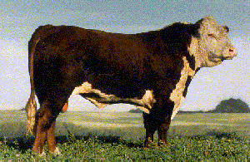
Polled Hereford

Slide 22
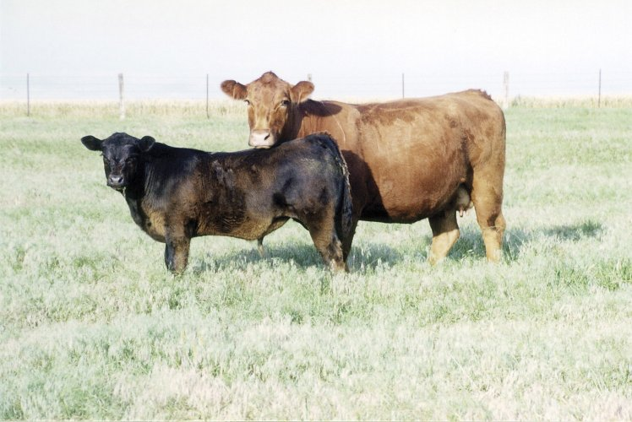
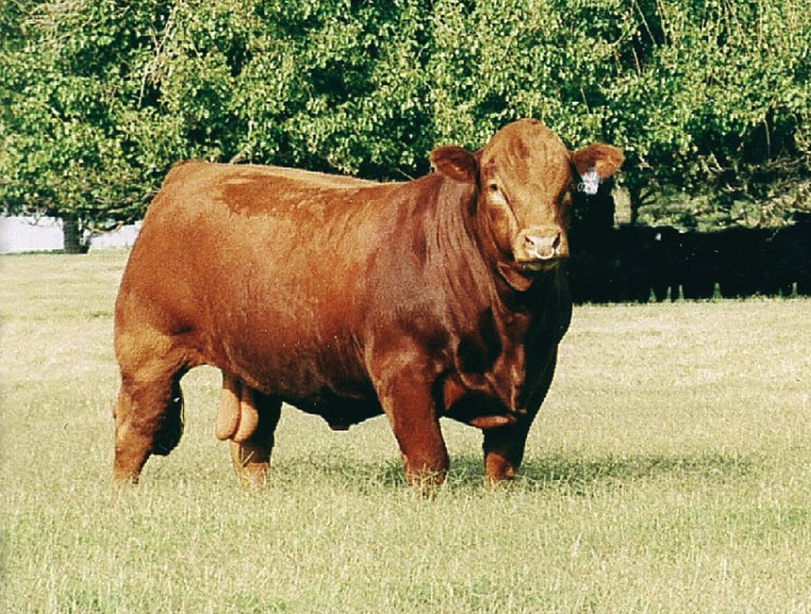
Limousin

Slide 23
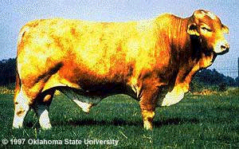
Beefmaster (Bull)

Slide 24
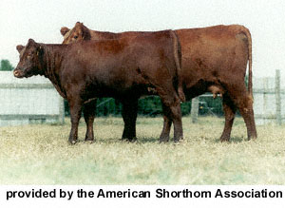
Shorthorn

Slide 25
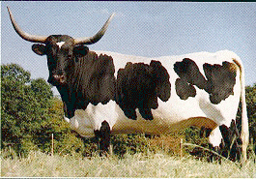
Texas Longhorn

Slide 26
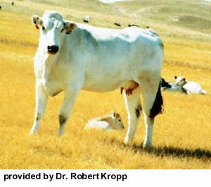
Chianina (pronounced kee-a-nee-na)

Slide 27
Dairy Breeds

Slide 28
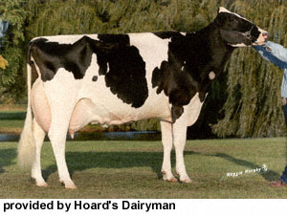
Holstein

Slide 29
Dairy Breeds
Holstein
  90% of the dairy cattle in the US
  Black and white
  Leading producer of milk
  Produce about 18,000 lbs. Of milk per cow per year

Slide 30
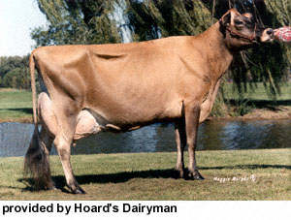
Jersey

Slide 31
Dairy Breeds
Jersey
  Cream to light fawn clolor
  Smallest framed dairy breed
  High butterfat content in milk

Slide 32
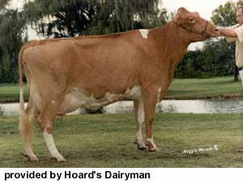
Guernsey

Slide 33
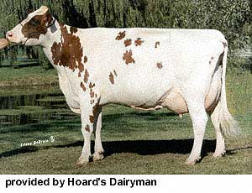
Ayrshire

Slide 34
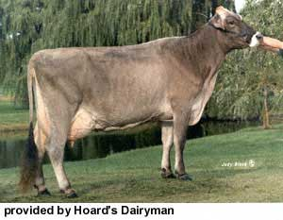
Brown Swiss

Slide 35
Identifying Breeds of Swine

Slide 36
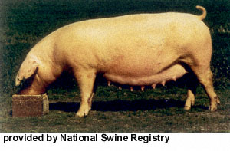
American Landrace

Slide 37
American Landrace
White
Long Body
Big loped forward ears
Large litters
Good mothering ability
Originated in Denmark

Slide 38
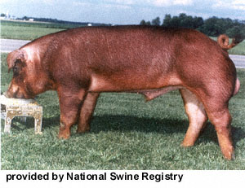
Duroc

Slide 39
Duroc
Red
Drooped ears
Good growth rate
Excellent feed conversion

Slide 40
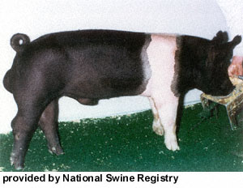
Hampshire

Slide 41
Hampshire
Black with a white belt
Erect ears
Good muscle
Carcass leanness

Slide 42
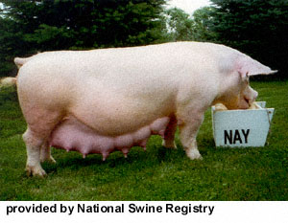
Yorkshire

Slide 43
Yorkshire
White
Erect ears
Large litters
Good feed efficiency
Excellent growth and mothering ability
Long carcass

Slide 44
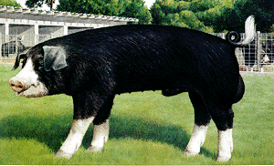
Poland China

Slide 45
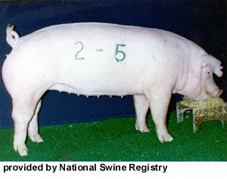
Chester White

Slide 46
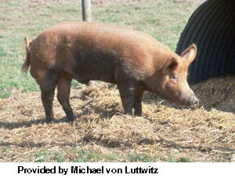
Tamworth

Slide 47
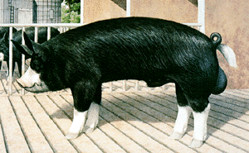
Berkshire

Slide 48
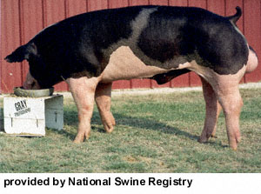
Spotted Swine

Slide 49
Identifying Breeds of Poultry

Slide 50
Poultry Identification
No breed registries for poultry unlike other farm animals
Most commercial producers develop their own breeds through crossbreeding

Slide 51
Breeds, Varieties, Types & Classes
Breed- group of related fowl that breed true for a specific trait
Type- purpose for which it is breed (meat or egg type)
Classes- geographic origin (Mediterranean, American, English and Asiatic)

Slide 52
Egg Producers
Layers- chickens that produce eggs
White egg producers- small in size
  White Leghorns- white plumage
Brown egg producers- larger birds that are not as economical as Leghorns
  Rhode Island Reds- dark red plumage
  New Hampshires- red plumage
  Plymouth Rocks- white plumage

Slide 53
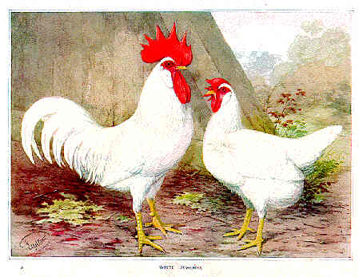
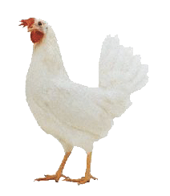
White Leghorns

Slide 54
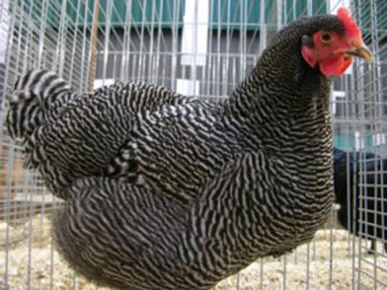
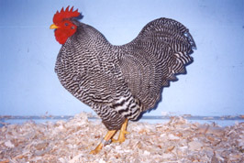
Barred Rock

Slide 55
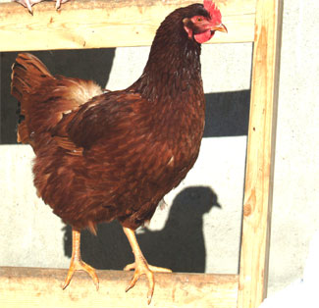
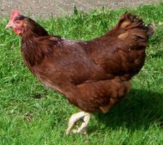
Rhode Island Red

Slide 56
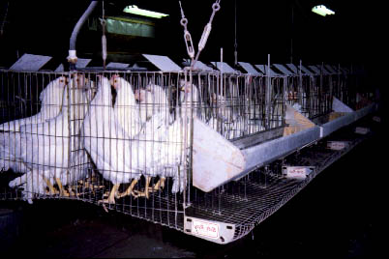
Layer Cages

Slide 57
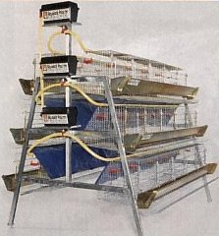
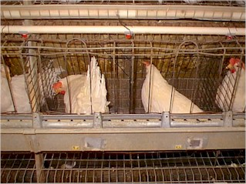

Slide 58
Meat Producers
Chickens used for meat production are called Broilers
Birds used for meat production are usually commercial crosses
  Example: White Plymouth Rock females mated to Cornish (English class) males

Slide 59
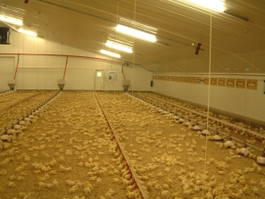
Confinement Broiler House

Slide 60
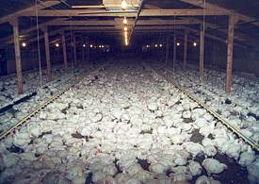
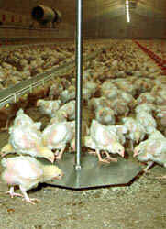
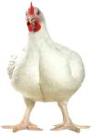
Confinement Broiler House

Slide 61
Turkeys
Broad Breasted White
White plumage
Shanks, feet, and beak is white to pink
White pinfeathers
  Increases the value of the carcass
Can survive better in hotter climates
Good body confirmation but smaller than other breeds

Slide 62
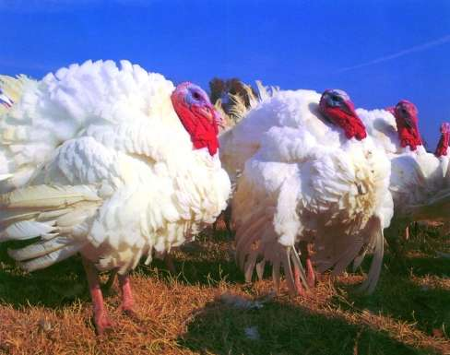
Broad Breasted White

Slide 63
Turkeys
Broad Breasted Bronze
Black plumage
Dark colored pinfeathers
Largest of the turkey varieties
Poor fertility and reproductive problems
  Males are not good breeders

Slide 64
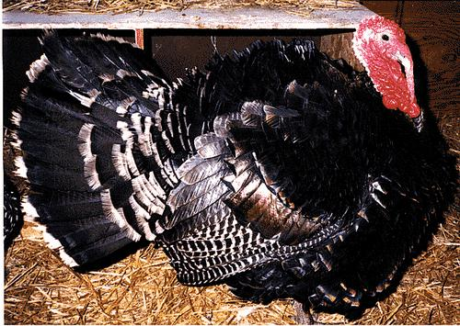
Broad Breasted Bronze

Slide 65
Turkeys
Beltsville Small Whites
Developed by the USDA
Similar to the Broad Breasted Whites
Averages about 10 lbs. less in mature body weight

Slide 66
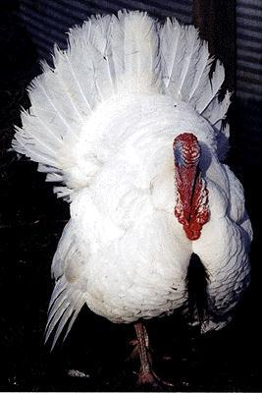
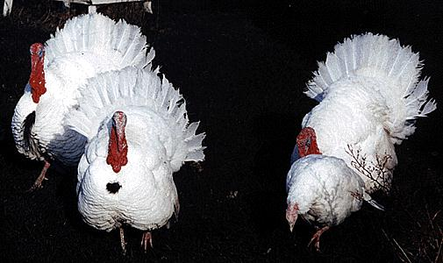
Beltsville Small Whites

Slide 67
Cuts of Meat
Objective 3.02: Recall retail and wholesale cuts of meat

Slide 68
Meat Carcass Information
Beef, Pork, Lamb, and goat animals that are processed before 2 years of age typically yield higher quality meat.
Older animals are processed, but meat quality is usually lower.

Slide 69
Processing
After following humane guidelines for stunning an animal, the carcass is bled out and hung upside down on a rail for further processing.

Slide 70
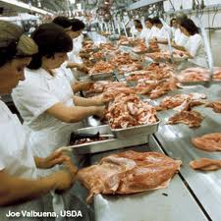
Processing
Animals are initially processed into wholesale or “primal” cuts.
These are broken into either sub-primal cuts and/or a variety of retail cuts

Slide 71
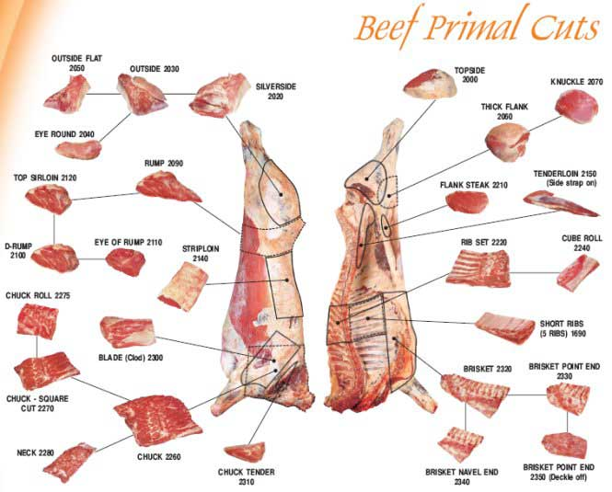
Cut Examples
Beef
  Wholesale/Primal: Chuck
  Sub-Primal: Blade
  Retail: Blade Steak
Pork
  Wholesale/Primal: Loin
  Sub-Primal: Tenderloin
  Retail: Loin Chops

Slide 72
Cuts of Beef

Slide 73
Cuts of Beef
Wholesale/Primal
  High value
    loin, rib, rump, round
  Low Value
    chuck, brisket, flank, plate or navel, shank
Notes:
1

Slide 74
Cuts of Beef
Draw a diagram in your notebook labeling the wholesale cuts of beef:
  loin
  rib
  rump
  round
  chuck
  brisket
  flank
  plate or navel
  shank

Slide 75
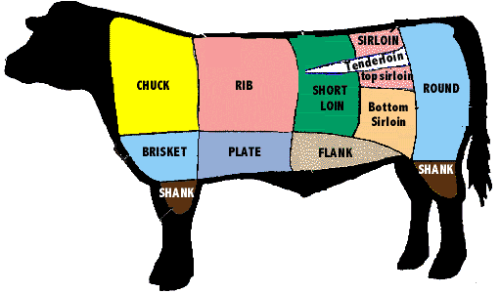
Wholesale Cuts of Beef

Slide 76
Cuts of Beef
Retail
  High Value
    ribeye from the rib
    tenderloin from the loin
    sirloin from the loin
    rump from the rump
    T-bone form the loin

Slide 77
Cuts of Beef
  Low Value
    Stew Beef, Ground Beef, Cubed Steak, Brisket

Slide 78
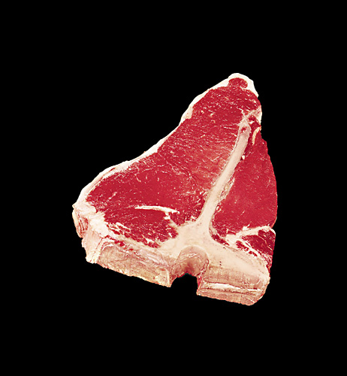
T-Bone

Slide 79

Ribeye

Slide 80

Tenderloin

Slide 81

Cuts of Beef
Ribeye
Tenderloin
Sirloin
T-Bone
Stew Beef
Ground Beef

Slide 82
Cuts of Pork

Slide 83
Cuts of Pork
Wholesale
  High Value
    loin, ham, picnic shoulder, Boston shoulder or butt
    The ham, picnic shoulder, and boston shoulder make up 75% of the carcass retail value

Slide 84
Cuts of Pork
  Low Value
    spareribs or belly, feet, jowl, backfat, spareribs or side, bacon

Slide 85

Wholesale Cuts of Pork

Slide 86
Cuts of Pork
Retail
  High Value
    ham, loin, tenderloin, pork chops, Boston butt, picnic ham (shoulder)
  Low Value
    hocks, spareribs, belly, bacon, jowl, fatback

Slide 87

Cuts of Pork

Slide 88
Cuts of Pork
Pork Chops
Boston Butt
Picnic Shoulder
Country Ham
The Ham, Loin, Picnic Shoulder and Boston Butt make up 75% of the retail value of the carcass

Slide 89
Cuts of Poultry

Slide 90
Cuts of Poultry
Not Classified into wholesale and retail cuts like pork and beef due to size
USDA sets standards for all “ready to cook” chicken and turkey

Slide 91
Cuts of Poultry
Parts include
  Halves
  Breast
  Legs
  Drumstick
  Wing
  Tenderloin

