Slide 1
Impact of animal agriculture
Objective: 5.01: Explain the economic impact of animal agriculture.

Slide 2
Animal Products

Slide 3
Livestock Products
1. Food
meat, milk, cheese, eggs
2. Clothing
wool, leather from hides
3. Shelter
tents from hides
4. Power
work in less developed countries

Slide 4
Livestock Products
5. Recreation
horse back riding, rodeos
6. Fuel
burn dry animal manure
7. Animals are converters
eat stuff humans will not eat and convert these materials into food
meat, eggs, milk, etc.

Slide 5
Which of the following was not made from animals:

Slide 6
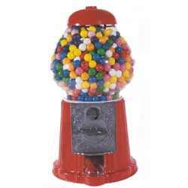
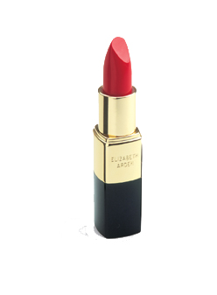
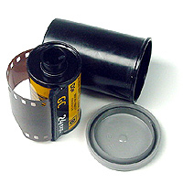
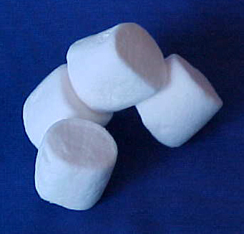
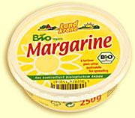
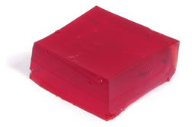
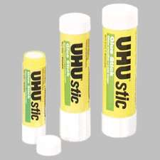
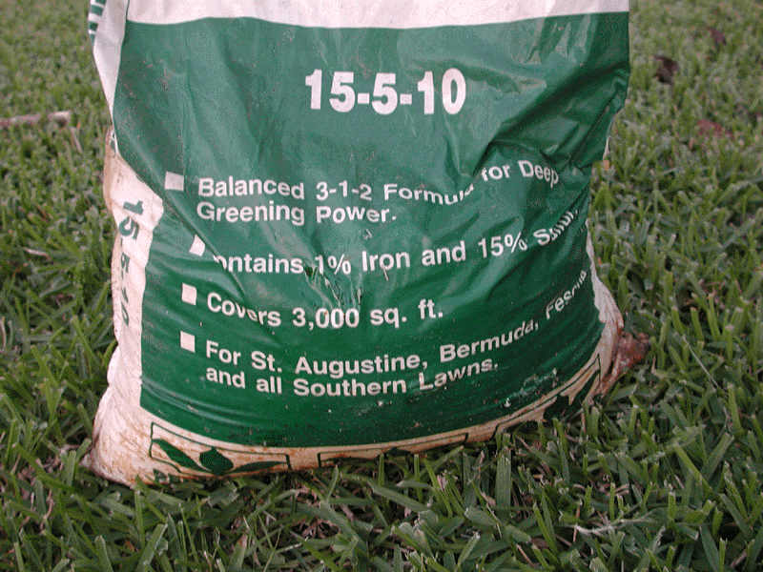
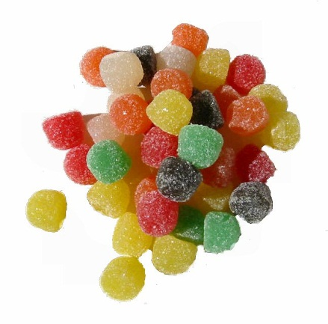

Slide 7
Answer!

Slide 8
What are animal by-products?
(Research and answer in your notebook.)

Slide 9
By-Products
1. Wool
2. Leather
3. Candy and chewing gum from animal fat
4. Gelatin - from horns, hooves, bones, and hides
5. Glue, cosmetics, waxes, soap, lubricants, brushes, etc.

Slide 10
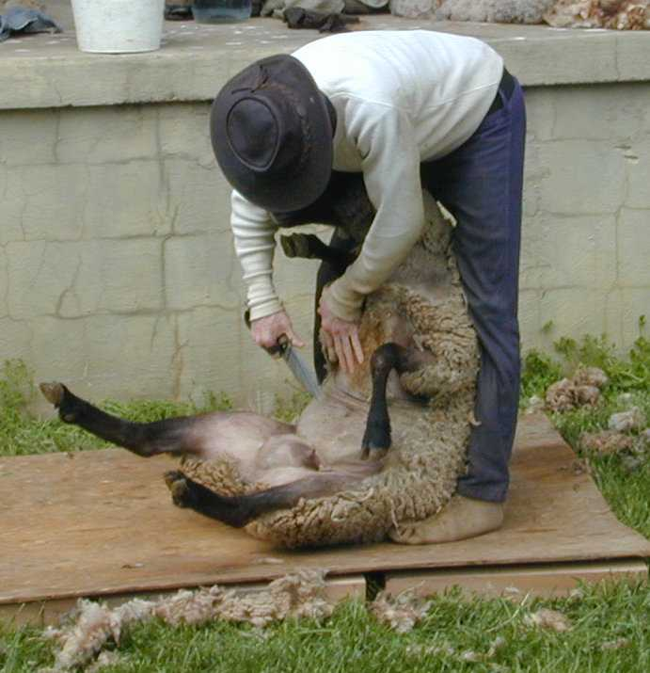
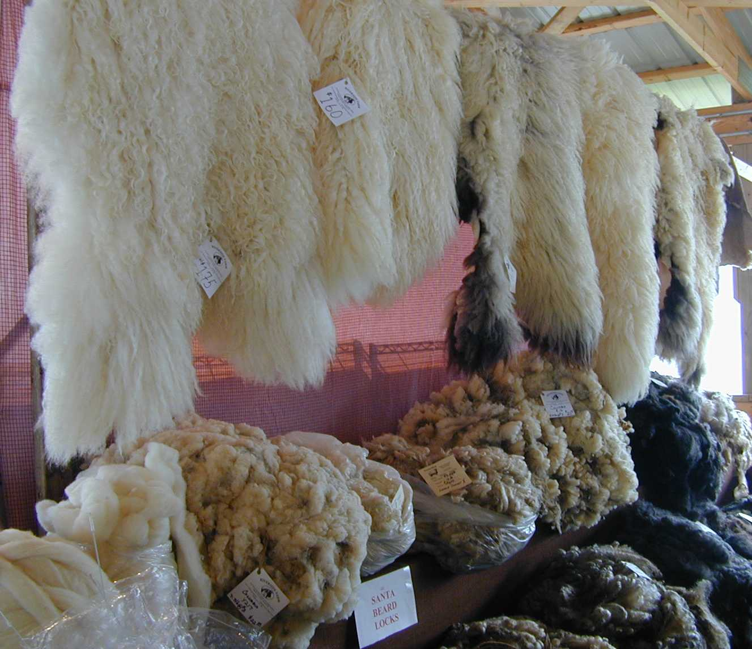
Wool

Slide 11
By-Products
6. Animal feeds from scrap meat and bones and blood meal
7. Insulin
for diabetics
from livestock pancreas

Slide 12
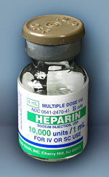
By-Products
8. Heparin
for blood clotting
from livestock lungs
9. Lanolin
- Oil from Sheep's Skin
10. Fertilizer, Printer Ink,
Lubricants

Slide 13
Economic Impact & Importance

Slide 14
Money, money, Money
Broilers = $2.6 billion per year
Hogs = $2.5 billion per year
Turkeys = $775,000 dollars
Cattle = $275,000 per year
Income from livestock, poultry, and their products is about twice that of crop production in NC!
NC is near top nationally in hogs, turkeys, and poultry

Slide 15
Trends in North Carolina
Swine farms are getting fewer and larger
Health concerns have caused an increase in the consumption of poultry
Most poultry farms are contract growers
Most swine farmers grow on contract

Slide 16
Animal Welfare and Rights

Slide 17
Animal Welfare
Humane treatment of animals
Most animal producers and researchers believe in animal welfare
support animal nutrition
oppose cruel treatment

Slide 18
Animal Welfare
Scientific information should be the basis for decisions, laws, and regulations related to animal welfare
It is difficult to assess animal comfort because they do not talk and there are no universally accepted measures to use

Slide 19
Animal Welfare
Laws that Protect Animals
Animal Welfare Act – Sets minimum standards for animals used for sale, research, transport, and exhibited
Last updated 2008
Health Research Act – Passed in 1985, Standards for animals used in biomedical and behavior research

Slide 20
Animal Rights
Animals should not be used by humans
The issues of animal welfare and animal rights date back thousands of years to the ancient Greeks
Largest animal rights group is the Humane Society of the United States

Slide 21
Welfare vs Rights
Welfare
Rights
Involves good treatment of animals
Less radical
Supported by most animal producers and researchers
No use whatsoever
Radical activities including violence
Usually vegetarians

