Slide 1
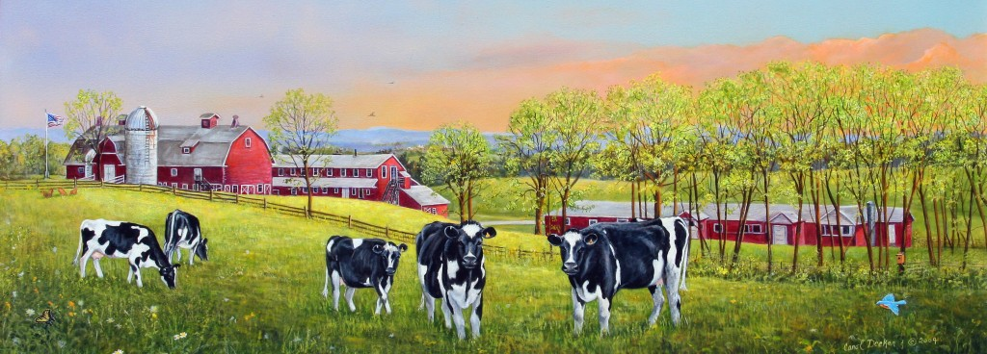
Animal Agriculture Processes
Objective 5.02: Understand the process for producing, breeding and marketing agriculture animals.

Slide 2
Animal Agriculture Process
The process for producing and caring for animals varies greatly depending on the type of animals, location, facilities and overall producer goals.
There has been an increase in consumer demand for locally grown and organically raised products.

Slide 3
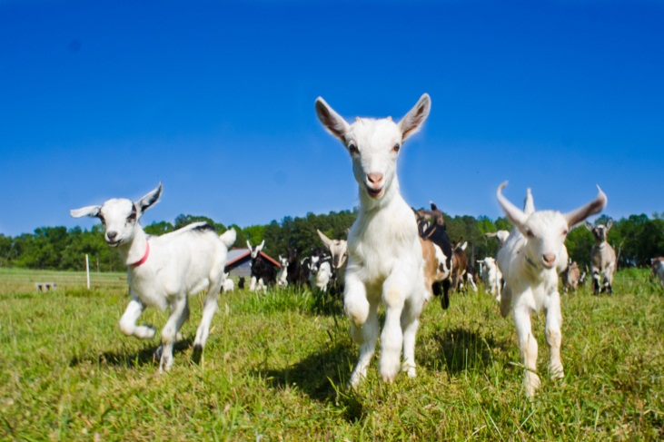
Animal Agriculture Process
Consumers have increased their awareness of how agriculture products are raised and manufactured.
The majority of livestock and poultry products are still produced and sold to commercial corporations who re-distribute them through various outlets such as grocery stores.

Slide 4
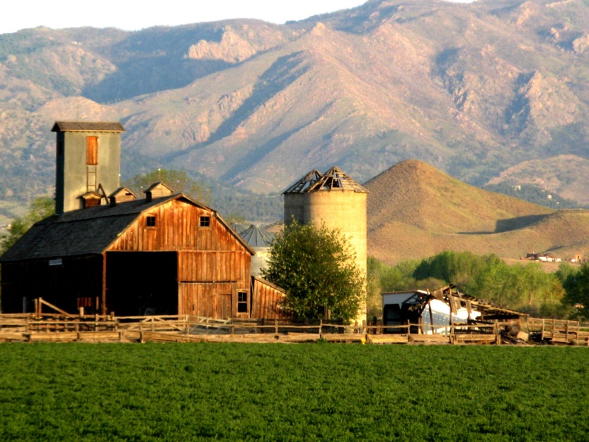
Producers must decide:
Goal of production and purpose of animals.
The type of breeding system to use based on how they elect to produce the animals.
How to market the animals.

Slide 5
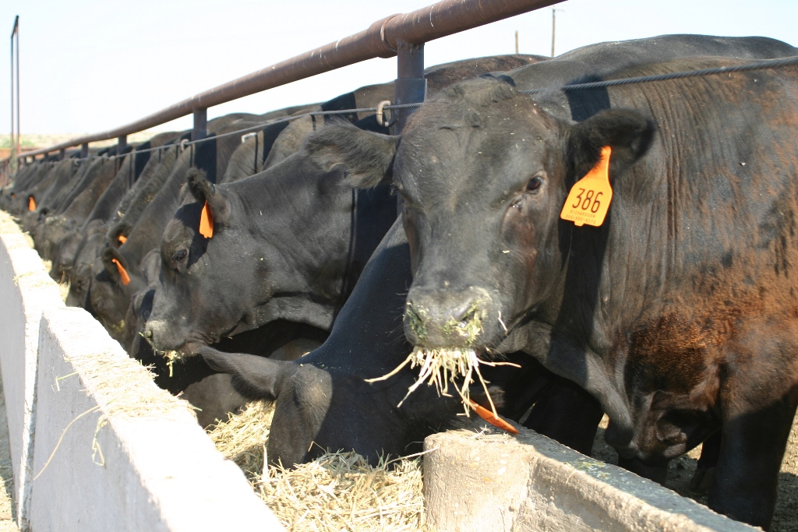
Beef Cattle Production

Slide 6
Types of Beef Cattle Operations
Beef cattle producers may specialize in one type of cattle operation or combine various types.
Cow-Calf Producers- a herd of cows are bred each year to produce calves. These calves are often sold sometime after weaning (6 months to 1 year old animals).

Slide 7
Types of Beef Cattle Operations
Seedstock-
Also known as purebred breeders.
Keeps herds of purebred breeding animals and provide replacement bulls for cow-calf operations.
These operations focus more specifically on genetic improvements within a given breed.

Slide 8
Types of Beef Cattle Operations
Cattle Feeders
Stocker Operations-
Purchase calves from a cow-calf producer and care for them for approximately 5 months (12 months to 17 months of age).
Feedlot-
Raises large numbers of animals in a more confined area.
Animals are fed to a “finished” market weight and then sent to be processed between 18-22 months of age.
Feedlot animals are purchased from stockers or cow-calf producers through one of the various types of livestock markets.

Slide 9
Processing Beef Products
Feedlots sell animals to packing plants (slaughter houses).
Most packing facilities process animals into primal cuts and subprimal cuts. These products are sold to retailers and foodservice companies.
Some packing facilities sell subprimals to meat processors who create value added products such as pre-cooked items, sandwich meat, etc.

Slide 10
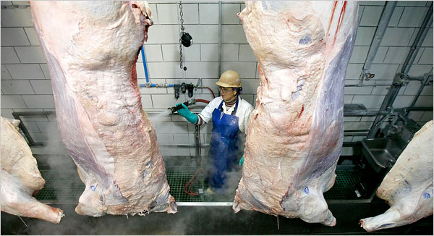
Processing Beef Products
The amount of time involved in producing beef cattle is significantly longer compared to swine and poultry.
Most beef cattle are grown independently, not on contracts.

Slide 11
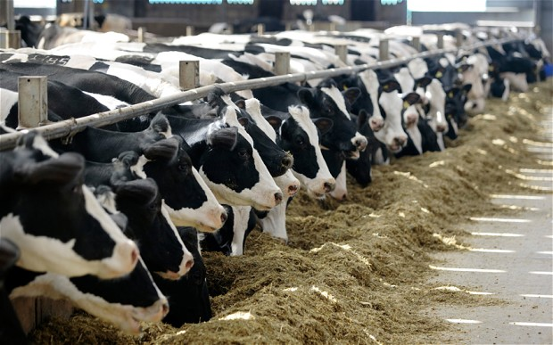
Dairy Cattle Production

Slide 12
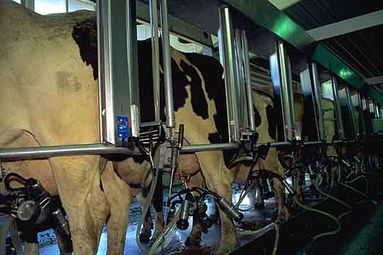
Dairy Cattle Production
Dairy cattle production in the United States continues to shift towards larger herds that allow producers to maximize production and profits.

Slide 13
Types of Dairy Cattle Operations
Intensive Dairy Production
Animals are raised in a more confined setting such as an open lot or tie stall barn.
Pasture Dairy Production
Cattle are turned out on pasture continuously or for portions of the day.
Some producers us a combination of both types.

Slide 14
Production Cycle of Dairy Cattle
Mature cows are milked 2-3 times a day after they give birth and their lactation cycle begins.
Calves are removed from the cow 1-2 days after being born.
A. Male calves are typically used for veal or are raised as slaughter steers.
B. Heifers are either kept to become replacements or are used for meat.
C. Replacement heifers are typically raised in feedlot or pasture settings until they are ready to be moved in with the dairy herd.

Slide 15
Production Cycle of Dairy Cattle
Replacement heifers are bred around 15 months of age and begin producing milk 9 months later (2 years of age).
During the lactation cycle, cows are re-bred.

Slide 16
Production Cycle of Dairy Cattle
Approximately 60 days before they give birth again, they are “dried off” (quit producing milk) in preparation for their next calf to born.
The average production cycle of dairy cattle is 5-7 years. Animals are then processed for their meat.

Slide 17
Processing Dairy Products
Milk is collected into large tanks at the farm and then transported to processing facilities.
The fluid milk is separated and then re-blended to make skim, 2%, whole milk, etc.
Fluid milk is pasteurized and homogenized.
Pasteurization- rapid heating and cooling of milk to remove harmful bacteria.
Homogenization- dispersing fat droplets so the milk stays uniformly mixed.

Slide 18
Processing Dairy Products
The excess fat removed from the fluid milk to make low fat milk such as skim and 2% is used to make products such as eggnog, butter, whipping cream, etc.
Other dairy products made from fat and butterfat at value added facilities include ice cream, yogurt and cheese.

Slide 19
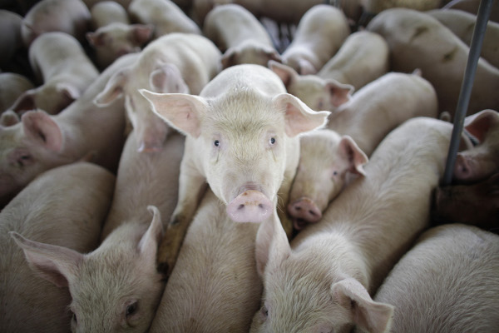
Swine Production

Slide 20
Swine Production
Most swine are grown through vertical integration contracts.
Vertical Integration Definition
Two or more steps of production, marketing, and processing are linked together usually by contract between producers and feed manufacturers or between producers and processors or include all three.

Slide 21
Vertical Integration Example
A corporation such as Smithfield Foods, Inc. purchases feeder hogs from a producer and then raises the animals to a market weight in their company owned finishing house. Then they transport animals to the slaughter house that is also owned by Smithfield Foods, Inc.
Commercially produced swine are typically raised in confinement type houses.

Slide 22
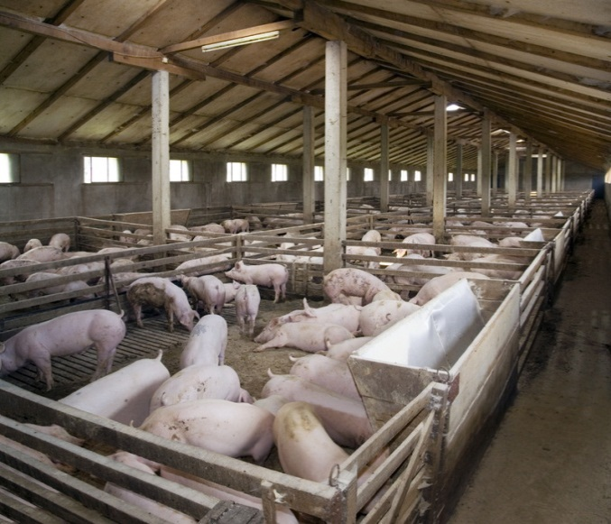
Types of Swine Operations
Sow-
Maintains sows for breeding, gestation and farrowing. Manages piglets until they are weaned at approximately 21 days.
Nursery-
Manages piglets after they are
weaned until approximately
10 weeks or 50lbs.
Grow-Finish-
Manages barrows and gilts until they are ready for market.

Slide 23
Types of Swine Operations
Farrow-to-Finish-
Manages a group of breeding sows and maintains piglets to market weights. Also known as complete sow and litter operation.
Commercial operation will typically house animals in separate facilities to manage disease.
Typical operation for a small scale producer raising hogs for local markets.

Slide 24
Processing Pork Products
Finishing operations send animals to processing facilities. In many cases the finishing operation and the slaughterhouse are vertically integrated.
Pork is processed into primal cuts and subprimal cuts. These products are sold to retailers and foodservice companies.
Some packing facilities sell subprimals to meat processors who create value added products such as ham, bacon, pre-cooked items, sandwich meat, etc.

Slide 25
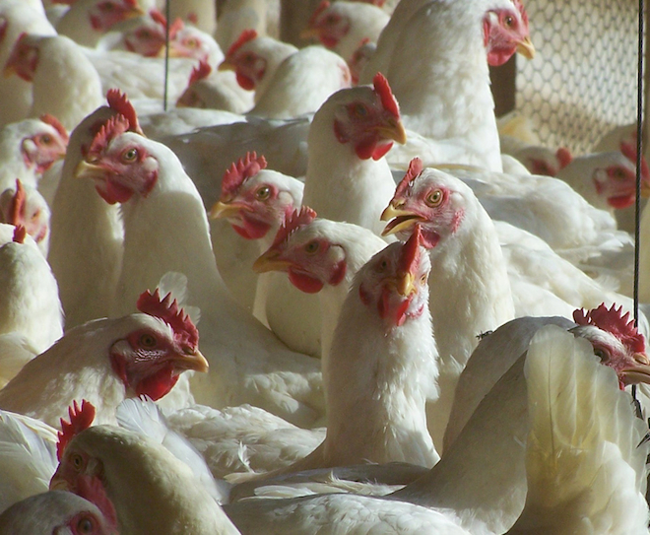
Poultry Production

Slide 26
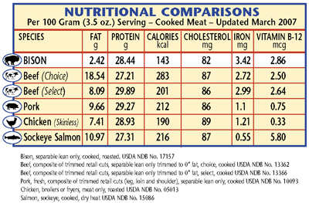
Poultry Production
Most poultry in the United States is produced through vertical integration contract with large commercial operations.

Slide 27
Egg Production
Laying hens are typically confined to cages or a floor-pen system.
Eggs are cleaned, graded and packed at the farm.
The laying hens produce eggs for approximately 72 weeks and then they are then sold for meat once their production cycle is complete.
Over ½ of laying hens are raised through vertical integration contracts.

Slide 28
Broiler Production
Poultry are fed high quality feed to maximize growth.
Hormones cannot be added according to USDA standards.
A producer will raise several flocks of birds each year.

Slide 29
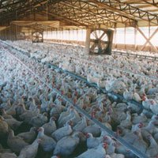
Broiler Production
Broilers are processed into cuts of meat and also value added products such as sandwich meat, pre-cooked products, etc.
Approximately 99% of broilers are raised through vertical integration contracts.

Slide 30
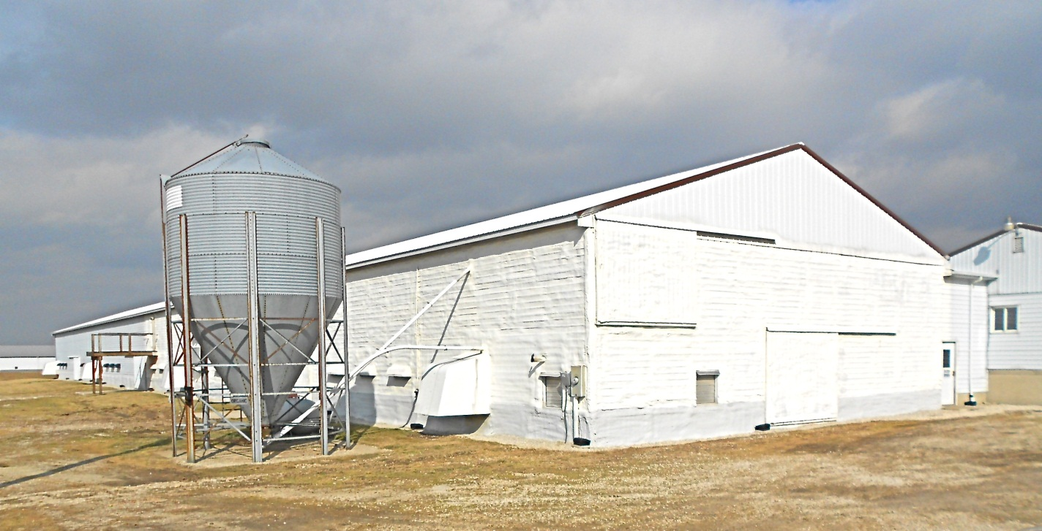
Replacement Pullet Production
Raising chickens to replace either egg production or broiler production operations.

Slide 31
Breeding Livestock Animals
Various breeding systems exist due to the various types of livestock operations.
The size of the herd, amount of money available and goals of the producer are all factors that determine the type of system used.

Slide 32
Breeding Livestock Animal s
Some farms use more than one type of mating system.
In general, cattle use all types of breeding systems while swine and poultry tend to utilize crossbreeding to develop industry owned hybrids.

Slide 33
Types of Breeding Systems

Slide 34
Straightbreeding-
Mating animals of the same breed. Types of straightbreeding systems:
Pure-breeding
Inbreeding
Grading Up

Slide 35
Purebred Breeding
Mating registered purebred male and female of the same breed.
Animals are eligible for registry with a purebred association.
Example: Angus x Angus

Slide 36
Inbreeding
Mating closely related animals. Increased the genetic purity of the stock produced, but is not used as often by the typical producer.
Two types of inbreeding:
Closebreeding- mating animals that are very closely related.
Example: son X mother
Linebreeding- mating animals more distantly related than closebreeding.
Example: cousin to cousin

Slide 37
Grading Up
Mating purebred males (sires) to grade or unregistered or crossbred females (dams) to improve the herd.

Slide 38
Crossbreeding
Mating a male and female of different breeds. Usually results in improved traits of the offspring which is referred to as hybrid vigor.
Example: Yorkshire boar x Yorkshire – Hampshire sow

Slide 39
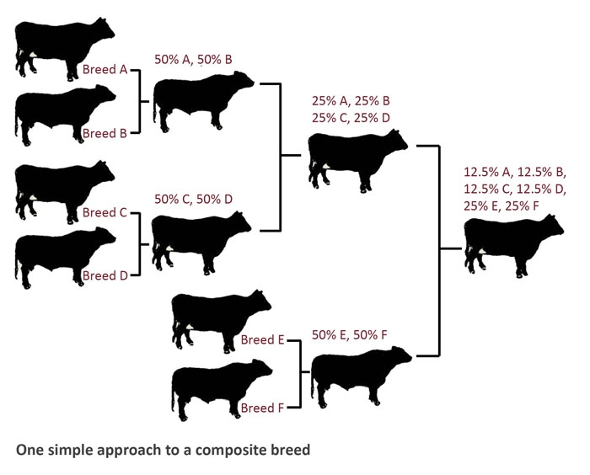

Slide 40
Crossbreeding Systems Include
Terminal sire
Replacement females are bred to a sire and all offspring are sold.
Rotational
Uses a two, three or four breeds to rotate between sires and females.
This system requires more intensive management.

Slide 41
Methods of Marketing Animals
Terminal Markets-
Central markets on public stockyards where livestock are consigned to a commission firm to bargain with purchasers or buyers for a certain fee.
Auction Markets-
Public bidding with the animals selling to the buyer who bids the highest.

Slide 42
Methods of Marketing Animals
Direct Selling-
Farmer sells straight to buyer with no middle person or firm receiving commissions or fees.
Electronic Marketing-
Auctioning online using computers.

Slide 43
Methods of Marketing Animals
Futures Market and Hedging-
Legal document calling for delivery in the future, locking in a future delivery price.
Vertical Integration Contracts-
Animals are produced as well as marketed as a part of the vertical integration enterprise.

Slide 44
Vertical Integration Example
Tyson, Case, Purdue
Poultry Farmer or producer
Grain producer
Hatchery

