Slide 1
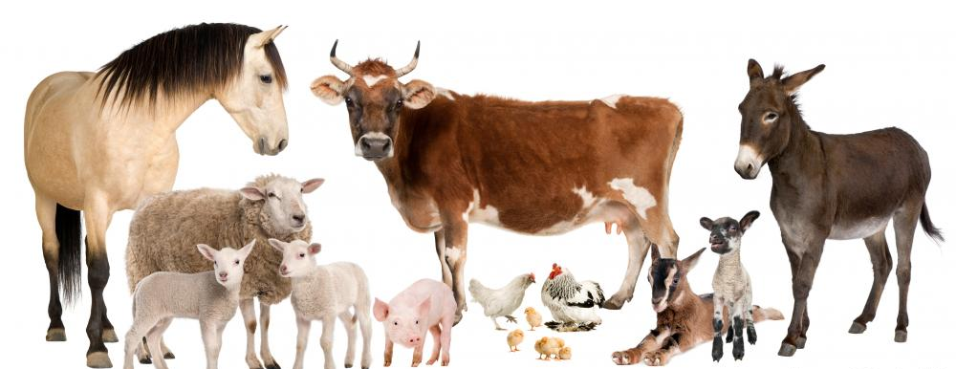
Animal Husbandry
Objective 6.02: Understand animal husbandry

Slide 2
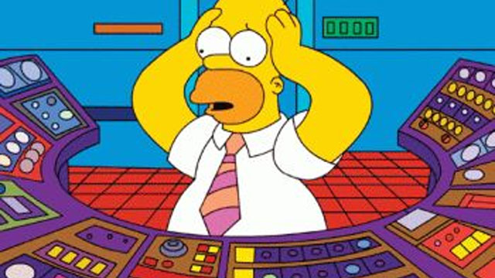
Common Causes of Human Injury
Human Error- poor judgment, working when tired lack of focus, etc.
Improper Training- workers are not properly trained on how to handle animals or equipment.

Slide 3
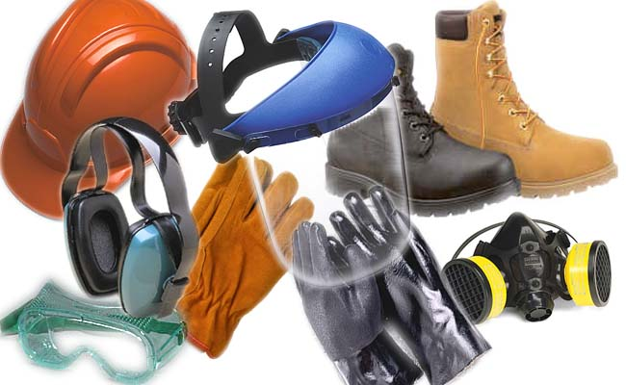
Common Causes of Human Injury
Failure to use personal protective equipment (PPE). Injuries occur from slippery floors, dusty conditions, etc when individuals do not use PPE.
Environmental factors such as poor ventilation.

Slide 4
Chemical Safety
All chemicals must be properly labeled and stored. Material Safety Data Sheets must be maintained.
Workers must be trained on how to use chemicals.
Personal Protective Equipment must be used and properly cleaned following contact with chemicals.

Slide 5
Animal Handling
Facilities- should provide safe environment for workers and animals.
Safe footing.
Adequate space to maneuver animals.
Properly working equipment.
Adequate lighting.

Slide 6
Animal Handling

Slide 7
Animal Behavior
Vision- livestock animals have a wider range of peripheral vision because their eyes are located on the sides of their head but have limited depth perception.
Animal vision causes reaction to movement and contrasting patterns.
Small objects or movements can distract animals and cause them to react.

Slide 8
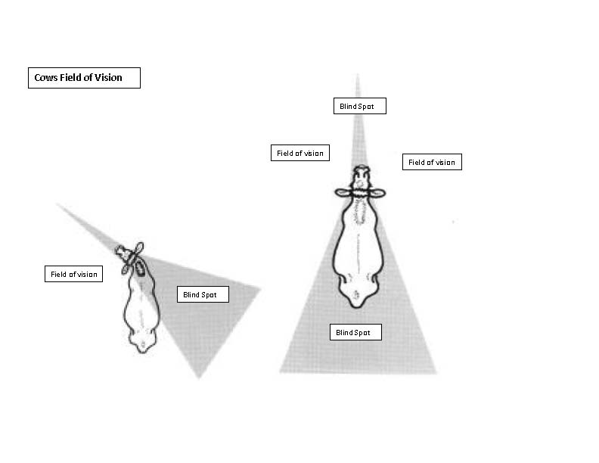

Slide 9
Animal Behavior
Noise- animals react negatively to loud noises and high-pitched sounds.
Excessive noise confuses animals.
Animals remember negative experiences.

Slide 10
Animal Behavior
Companion & livestock animals typically do not attack humans unless provoked or out of fear.
Animals tend to show aggression when cornered and they cannot escape. This concept of animal behavior is often referred to as “fight or flight.”
Animals will also show aggression when they are protecting their young.

Slide 11
Animal Handling Recommendations

Slide 12
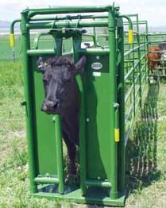
Animal Restraint-
Use recommended equipment to restrain animals:
Head Gate and Squeeze Chutes for Livestock- design facilities to meet recommended specifications such as curved chutes with solid walls to encourage animals to move better and with less stress.

Slide 13
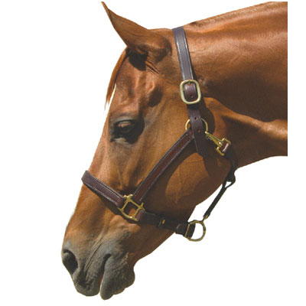
Animal Restraint
Halters- use halters to tie horses and restrain cattle, sheep and goats.
Muzzles- use muzzles to restrain companion animals such as dogs and cats.

Slide 14
“Flight Zone” of Cattle-
The imaginary circle that surrounds an animal or herd. When humans enter the flight zone, animals react and attempt to move away. Understanding the flight zone helps handlers efficiently move livestock.

Slide 15
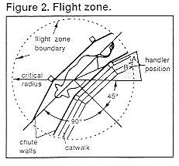

Slide 16
Awareness of Animal Behavior-
Watch for behavior of animals that indicate they are suspicious or scared:
Head raised.
Wide eyes.
Flaring nostrils.
Tense muscles.
Ear position.

Slide 17
Acclimating Animals to Human Contact-
Livestock are not accustomed to human contact as compared to companion animals.
Handlers should attempt to make human contact a positive experience. Avoid yelling, waving arms, and other loud noises.
Exposure to humans- animals remember both positive and negative experiences. Acclimate animals through routinely checking and handling animals.

Slide 18
Animal Management

Slide 19
Preventative Maintenance
Record Keeping- keep accurate breeding records, health protocols, production records, vaccination schedules, etc.
Feeding Practices- provide adequate nutrition to meet the needs of the individual animals.
Vaccination- utilize a vaccination program and correctly administer and store all vaccines for the prevention of diseases.

Slide 20
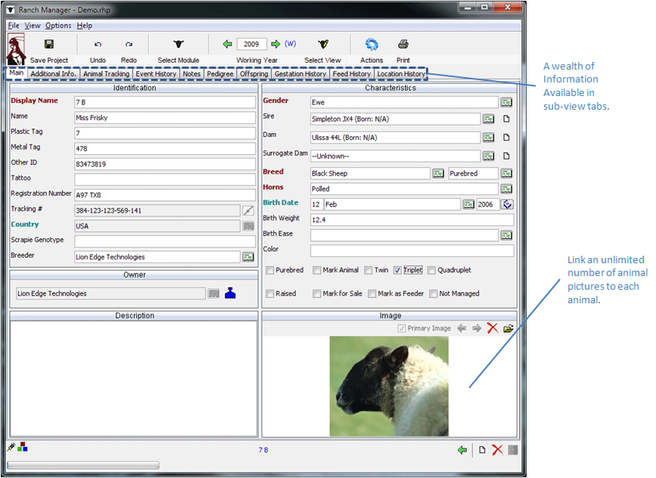

Slide 21
Preventative Maintenance
Parasite Control- follow recommendations and protocol for controlling internal and external parasites.
Animal Observation- routinely check animals and be familiar with typical behavior and vital signs.
Isolate new animals.
Detect visual signs that indicate disease:
Open wounds.
Isolation from the group.
Lethargic behavior.

Slide 22
Preventative Maintenance
Sanitation- maintain clean facilities and sanitize according to recommendations.
Biosecurity- protection from biological harm from living things including diseases, parasites, and bioterrorism. This can be accomplished by:
Limit the number of people who visit the farm.

Slide 23
Preventative Maintenance
Disinfect any equipment including footwear that is brought onto the farm from another location.
Sanitize and disinfect facilities, equipment, etc.
Keep adequate distance from one farm facility to the next even when owned by the same individual or company.

Slide 24
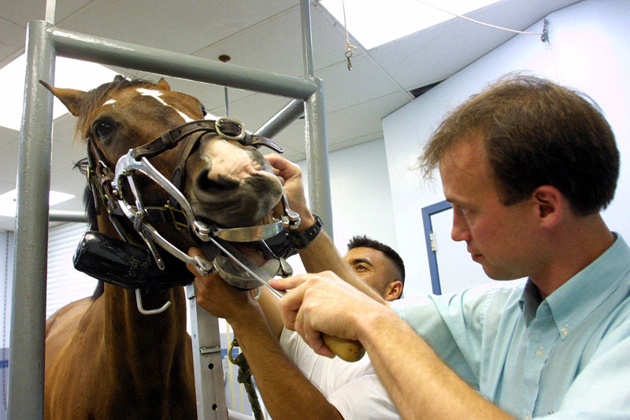
Veterinarian-
Consult with a veterinarian to establish a viable animal health program.

Slide 25
Diseases & Parasites

Slide 26
Noninfectious Diseases Causes
Faulty Nutrition- ration is not balanced.
Metabolic Disorder- not adequately digested.
Trauma- wounds or injuries.
Toxic substances- poisonous materials such as chemicals, plants, snakes and spiders.
Congenital Defects- birth defects.

Slide 27
Infectious Disease Causes
Virus- a microscopic infective agent that causes disease.
Common viruses include: influenza, rabies, shipping fever, etc.
Many viruses can be controlled by vaccinating animals.
Bacteria- one-celled microorganisms that can cause disease.
Common bacterial infections include: salmonella, e-coli, streptococcus, etc.
Bacterial infections can be prevented through proper sanitation and prevention of injury to animals that cause contact with bacterial agents.

Slide 28
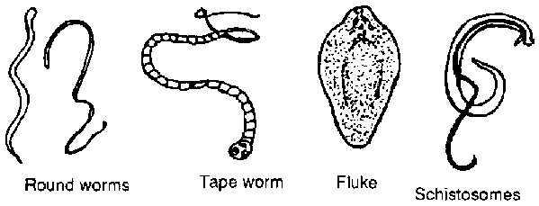
Infectious Disease Causes
Parasites
Internal Parasites- organisms that live inside of an animal.
Common internal parasites include: roundworms, heartworms, tapeworms, etc.
Internal parasites are controlled through routine de-worming programs, and pasture and herd management.

Slide 29
Infectious Disease Causes
External Parasites- organisms that affect the outside areas of an animal’s body.
Common external parasites include: flies, lice, mites, ticks, etc.
External parasites are controlled through chemical and biological methods.

