Slide 1
Animal Identification Systems
Objective 6.02: Classify animal and financial records.

Slide 2
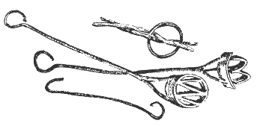
Identification Systems
Branding
cattle
Ear Tagging
cattle
goats
Ear Notching
swine
Tattooing
cattle
rabbits

Slide 3
Branding
Used mainly for cattle
Two types
Freeze Branding
Hot Iron Branding
Uses a metal instrument to burn or freeze a mark on the animal’s hide
Originally used to show ownership

Slide 4
Branding
Usually done after the animal is weaned
Permanent method of identification
The beef improvement federation recommends letter systems to mark year of birth
Example: 2013 = A, 2014 =B, etc.
Uniformity for all breeds can be accomplished
Reduces number of items on the animal

Slide 5
Angle Brand System

Slide 6
Angle Brand System
Answer: 95
What would be the number of this animal?

Slide 7
Angle Brand System
Answer:
140
What would be the number of this animal?

Slide 8
Angle Brand System
120
Answer:
What would be the angle brand of this animal?

Slide 9
Ear Tagging
Use special pliers to attach pieces with numbers on them
Easy to read from the front view
Not permanent
Can be lost or removed

Slide 10
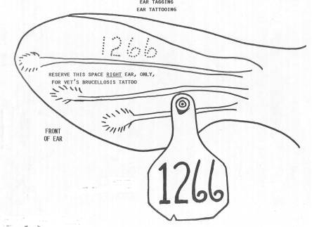
Ear Tagging

Slide 11
Tattooing
Uses a special tool to put inked numbers in an animal’s skin
Most commonly found in the ear
Can be used on the lips or other locations
Permanent
Simple and relatively painless
Hard to read from a distance

Slide 12
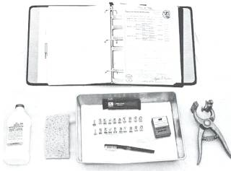
Tatooing

Slide 13
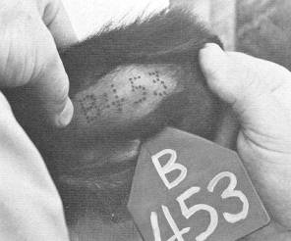
Tatooing

Slide 14
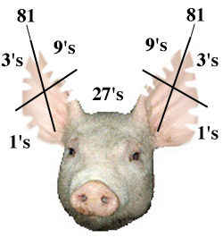
Ear Notching- Swine
Why Notch?
Universal Swine Identification system
Tags will come off in the feed pen

Slide 15
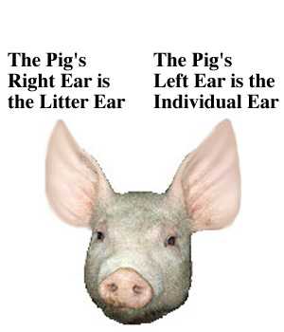
Ear Notching- Swine

Slide 16
Ear Notching- Swine
Individual Number
Litter Number

Slide 17
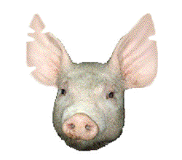
Ear Notching Quiz
What would be the litter number and individual number of this animal?

Slide 18
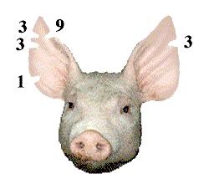
Ear Notching Answer
The right (litter) ear is equal to 9+3+3+1=16
The left (pig) ear is equal to 3
This is the 16-3 pig

