Slide 1
Introduction to SAEs
Supervised Agriculture Experiences

Slide 2
Read this carefully!
Wanted: Landscape Maintenance worker, Operate a lawn mower and power blower. Need a person who can work with out supervision. Experience required. Call 515-7743.

Slide 3
Read this carefully!
Vet Assistant needed. Mayflower Animal Hospital needs an experienced individual to work 20 hours a week. Duties including bathing animals, grooming and feeding of animals. Apply in person at 316 Walnut Street.

Slide 4
Read this carefully!
Wanted: Dependable person to handle over the counter sales in a busy garden center. Pay is $7.50 an hour. Neat appearance important along with the ability to work with people. Experience in working with plants a must. Call 515-2396 for an interview.

Slide 5
What was the same in all 3 ads?
Each advertisement wanted the person to be experienced. People who have experience have the edge in landing a job. But:
How do you get experience without first having a job?
How do you get a job without first having experience?
Job
Experience

Slide 6
Gaining Experience!!
Question:
How can you gain experience to get a job (or prepare for college)?
Answer:
Supervised Agricultural Experience (SAE)

Slide 7
Supervised Agricultural Experiences
The purpose of the SAE is to gain work experience in agriculture and build life skills.

Slide 8
What is SAE
SAE is a project completed outside of class time that deals with any division of agriculture
Plants
Animals
Agriculture Business
Agriculture Based Science Experiments

Slide 9
How Does a SAE Help Me?
Develop skills that can be used in getting a job
Provides the opportunity to make money
Develops skills that can be used in starting your own business
Helps development management skills

Slide 10
How Does a SAE Help Me...?
Learn record keeping skills
Improves analytical and decision making skills
Teaches responsibility
Provides the opportunity to explore possible careers

Slide 11
How Does a SAE Help Me...?
Develops knowledge and skills that could be helpful in college, as a hobby or for recreation.
Provides the opportunity to win awards: FFA proficiency awards are based on the SAE program. In addition to winning awards, money can be won at regional, state and national levels

Slide 12
How Does a SAE Help Me...?
FFA degrees are partially based on the SAE. You must have a SAE program to advance.
In order to be a state or national officer, you first must have an advanced FFA degree which is partially based on SAE.
Could help the grade in Agriculture class (SAEs count as 25% of your overall grade)

Slide 13
Types of SAE
Entrepreneurship
Research
Experimental
Analytical (non-Experimental)
Placement
Exploratory
Improvement
Supplemental

Slide 14
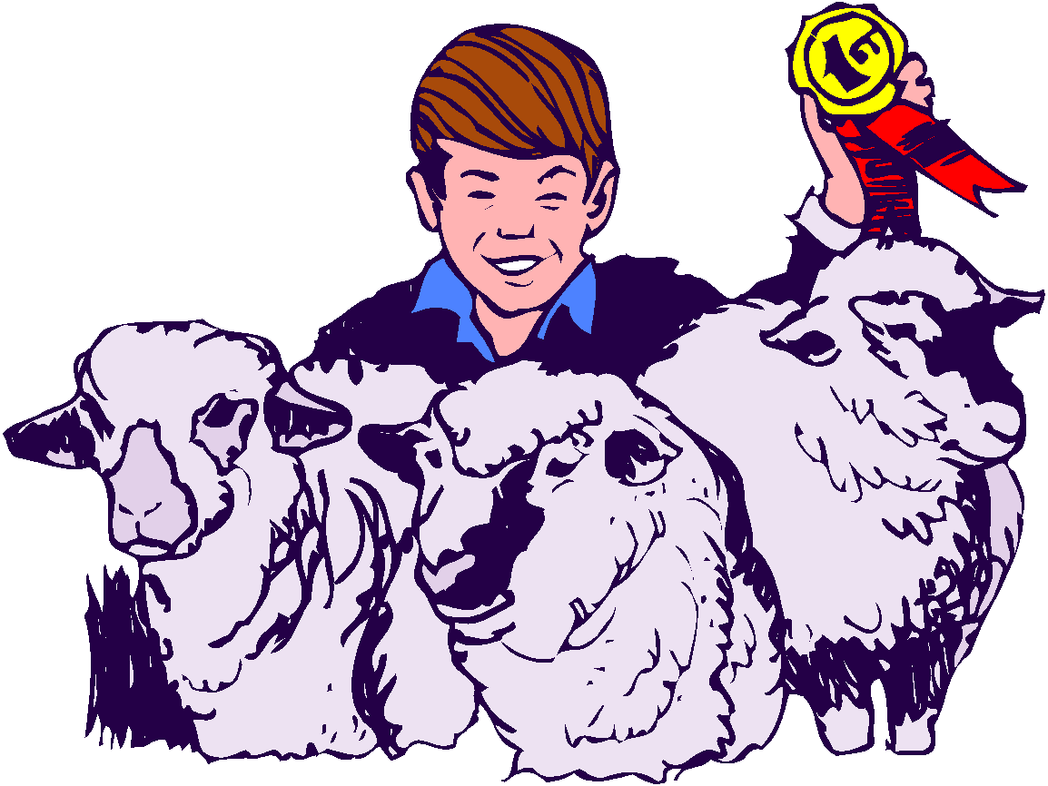
Entrepreneurship
Planning, implementing, operating and assuming financial risks in an agricultural business or farming activity.
The most “traditional” type of SAE

Slide 15
Entrepreneurship examples:
Raising plants to sell
Owning a lawn maintenance business
Owning a farm supply store

Slide 16
Entrepreneurship Record Book:
Type of Enterprise
Amount of items bought or sold
Expenses
Income
Efficiency factors
(etc)

Slide 17
Research...
There are two major types of Research Projects - Experimental and Analytical (Non-Experimental).

Slide 18
Experimental
Planning & conducting an agricultural experiment using the scientific process or scientific method.
The purpose of the experiment is to provide students "hands-on" experience in:
1. Verifying, learning or demonstrating scientific principles in agriculture.
2. Discovering new knowledge.
3. Using the scientific process.

Slide 19
Experimental Examples
Comparing different fertilizer rates on plants
Determining the impact of different levels of protein on fish growth
Comparing three rooting hormones on root development
Determining if phases of the moon have an effect on plant growth

Slide 20
Experimental Record Books
Review of literature
Hypothesis
Data Log
Findings
Recommendations
(etc.)

Slide 21
Analytical Research
Identifying an agricultural problem that cannot be solved by experiment. It does include designing a plan to investigate and analyze the problem.
The students gather and evaluate data from a variety of sources and then produce some type of finished product.

Slide 22
Analytical Examples:
Making a marketing display
A series of newspaper articles about the environment
A land use plan for a farm
A landscape design for a community facility
An advertising campaign for an agribusiness

Slide 23
Analytical Record Book:
Title of activity
Identification of problem
Background information
Steps to solve problem
Project log of what was done
Results
Recommendations.

Slide 24
Placement
Placing students in jobs outside of the regular classroom hours.
They may be paid or unpaid (volunteer) work.
Provides a "learning by doing" environment.

Slide 25
Placement Examples
Working at a farm supply store
At a greenhouse or for a landscape company.
Placement in a florist shop
Working on Saturdays at a riding stable
Working in the school greenhouse after school and on weekends and holidays
Placement on a general livestock farm

Slide 26
Placement Record Books
Training agreement signed by the student, teacher, employer and parent or guardian stating which each will do.
Record of work
Hours
Income

Slide 27
Exploratory
Helping students learn about agriculture and become aware of possible agricultural careers through short times spent observing, shadowing or helping.
You may have to combine more than one exploratory experience.
Exploratory SAE activities are appropriate for beginning agricultural students but is not restricted to beginning students.

Slide 28
Exploratory Examples:
Attending a career day.
Interviewing a veterinarian.
Assisting a horse owner.
Observing and/or assisting a florist
Growing plants in a milk jug "greenhouse"
Preparing a scrapbook on the work of a veterinarian

Slide 29
Exploratory Record Books:
Date
Activity
Observation
Comments
Hours

Slide 30
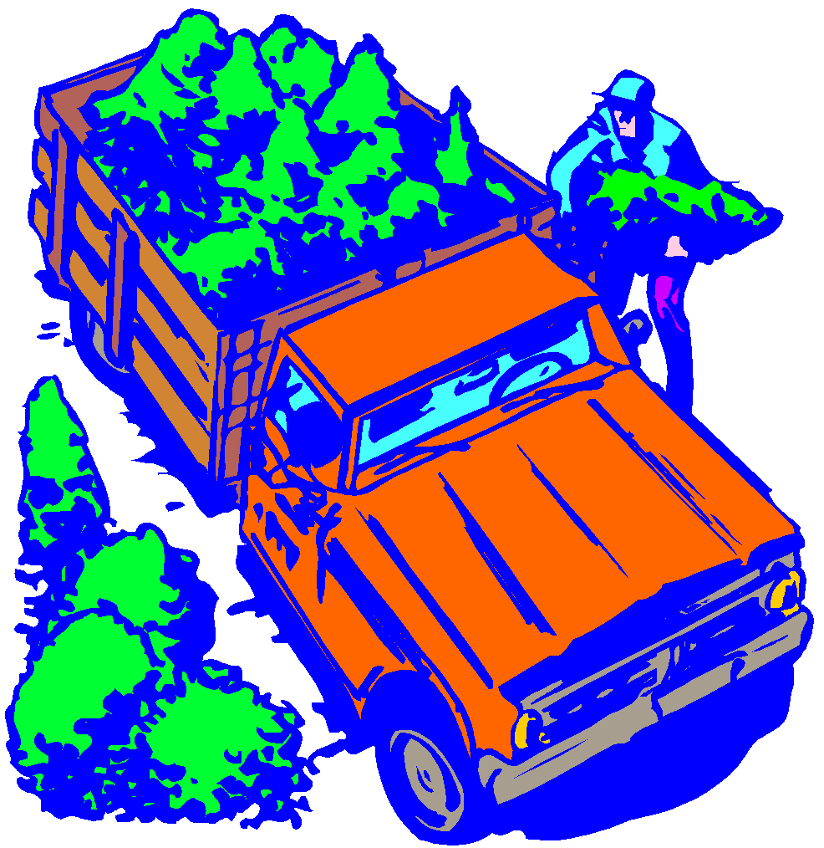
Improvement
A series of learning activities that improves the value or appearance of the place of employment, school, home or community; the efficiency of a business or an enterprise, or the living conditions of the family.
An improvement activity involves a series of steps and generally requires a number of days for completion.

Slide 31
Improvement Examples:
Building a fence
Computerizing records
Remodeling a building
Repairing equipment
Landscaping the home
Overhauling a piece of equipment
Renovating and restocking a pond

Slide 32
Improvement Record Books:
Date started
Date completed
Improvement activity
Steps or tasks involved in the project
Hours
Cost

Slide 33
Additions to your SAE...

Slide 34
Supplementary (Minor)
Performing one specific agricultural skill outside of normal class time.
This skill is not related to the major SAE but is normally taught in an agricultural program, involves experimental learning and contributes to the development of agricultural skills and knowledge on the part of the student.
The activity is accomplished in less than a day and does not require a series of steps

Slide 35
Supplementary Examples:
Pruning a tree
Staking tomatoes
Changing oil
Balling & burlaping a tree
Helping a neighbor castrate pigs
Cutting firewood with a chainsaw

Slide 36
Supplementary Record Book:
Date
Supplementary Activities
Comments
Hours

Slide 37
Why Should I have an SAE?
Develop job skills
Earn money
Win FFA Awards
Develop skills to start your own business
Develop skills and knowledge that are helpful in college or work
Learn about careers
Keep accurate records
Improve decision-making skills.

Slide 38
Record Keeping

Slide 39
Terms
Asset – something tangible of value that a person owns.
Current – Items quickly converted to cash or that will be sold within 12 months. Ex: cash, checking, savings, stocks, livestock.
Non-Current – Items that have a useful life of more than one year. Ex: land, machinery, breeding livestock, etc.

Slide 40
Terms
Liability – Debts.
Current – Debts that are due to be paid this year. Ex: fertilizer, feed bills, tractor and building payments, etc.
Non-Current – Debts not due this year. Ex: mortgages not including this years payment.

Slide 41
Terms
Net worth -
Total assets minus Total liabilities
Current Assets + Non Current Assets = Total Assets
Current Liabilities + Non Current Liabilities = Total Liabilities.

Slide 42
Terms
Inventory – an itemized list of things owned by a business with the beginning value and depreciated value.
Non depreciable – items that will be used or sold within a year.
Ex: feed, supplies, etc.
Depreciable – items that have a useful life of more than one year and lose value because of age, wear or becoming out of date because of technology advancements. Land is NOT depreciable property.
Ex: computers, tractors, cars, etc.

Slide 43
Smartie Farm
[Record Keeping Lab]

Slide 44
Inventory
Take Inventory of your “smarties farm” on your lab sheet

Slide 45
#__ Purple breeding cows $500
#__ Pink 1 acre of land $2,000
#__ White calves for sale barn $100
#__ Peach/Orange Tractor $1,000
#__ Yellow fertilizer for pasture $100
#__ Green seed bag (winter wheat for grazing) $100
Total Each- Ex: 2 breeding cows X $100= $200
Then, Total all farm items together for total farm value

Slide 46
Income
Sell all calves
◦For example, 3 calves ($300)
◦This means you may eat calf smarties
Calculate your Total Income

Slide 47
Expenses
Any costs associated with producing a product
Buy hay feed breeding cattle
($100 per cow)
Calculate total expenses

Slide 48
Profit
the excess of receipts (income)over payments (expenses)for all factors of production
Figure your profit, starting with income and subtract expenses If you get a negative #, then you have a loss instead of a profit For example $600 - $700= -$100

Slide 49
Non Depreciable Items
Before we move on to depreciation, you may eat your seed and fertilizer smarties (yellow & green)
The items you have eaten so far represent Non-Depreciable Items

Slide 50
Non Depreciable Items
Items that are sold within a year OR do not make you money themselves.
Qualifying: It doesn’t produce something for you OR you sell the actual item quickly
Common items include: (add to chart)
feed, seed, fertilizer, stocker cattle, feeder cattle

Slide 51
Depreciable Items
Items that make money for you over a period of time and can loose value over time
Qualifies if 1) used in business or held for the production of income. 2) has a useful life longer than one year
Common items include: (add to chart)
◦breeding livestock, Equipment (computers, tractors, etc.), land and land improvement

Slide 52
Depreciable Items
The items you have NOT eaten so far represent Depreciable Items.
As each minute passes, you may depreciate (EAT) one item.

Slide 53
AET
Use the SAE Record Book to become familiar with the types of entries required for each type of SAE

Slide 54
